Slide 1
State Accounting Business User Group (BUG)
Tuesday, December 1st, 2020
10:00 PM – 11:30 PM
WebEx Video / Conference Call

Slide 2
Agenda
LB381 Detail
State Accounting Policy Updates
Object Code Updates
Updated Expense Reimbursement Document (ERD)
ERD Training Video

Slide 3
LB381
Passed February 2020
Change from Actual Expense to Per Diem Reimbursement
Starts January 1, 2021

Slide 4
Sec. 111 Section 81-1174 2(b)
Notes:
For the first point, a service purchase order is not valid and will need to be received, closed out or cancelled prior to FEYE

Slide 5
State Accounting Policy Updates
General Policy #3 – Job-Applicant Expenses
General Policy #22 – State Employee Expenses While Not in Travel Status
Travel Policy #4 – Lodging
Travel Policy #5 – Substantiation of Expenses
Travel Policy #6 – Meals
Travel Policy #8 – Receipts
Travel Policy #9 – Reimbursement to One Employee for Two or More Employee’s Expenses

Slide 6
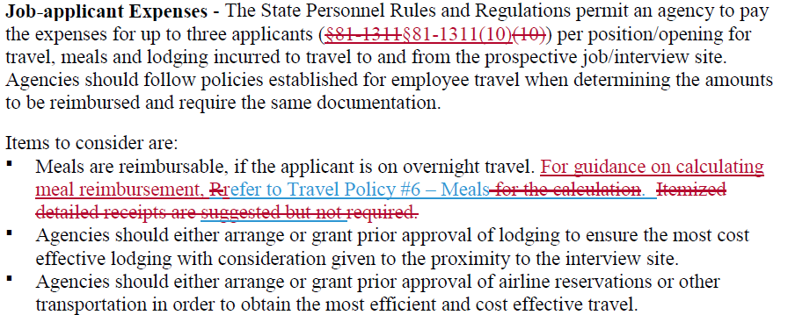
General Policy #3 – Job-Applicant Expenses

Slide 7
General Policy #22 – State Employee Expenses While Not in Travel Status

Slide 8
Travel Policy #4 – Lodging

Slide 9
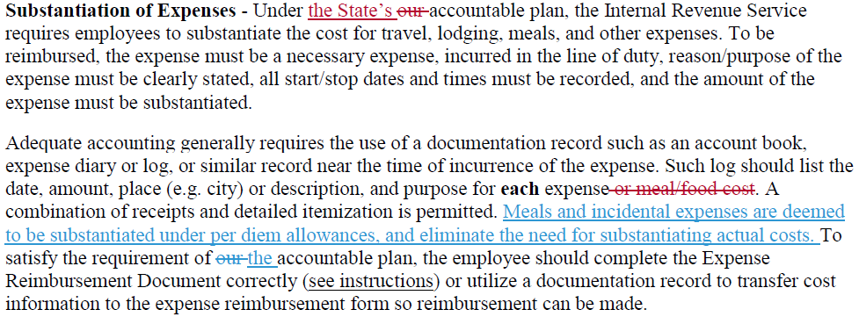
Travel Policy #5 – Substantiation of Expenses

Slide 10
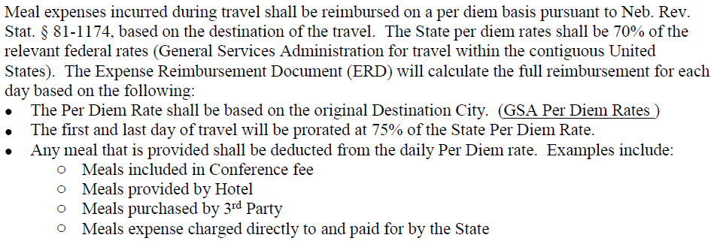
Travel Policy #6 – Meals

Slide 11
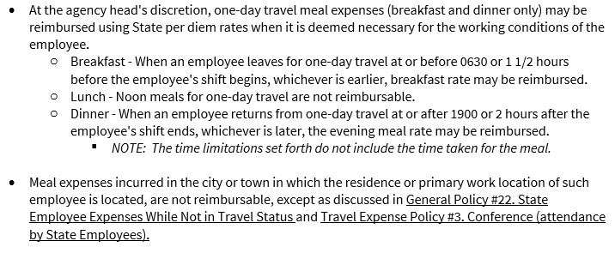

Slide 12
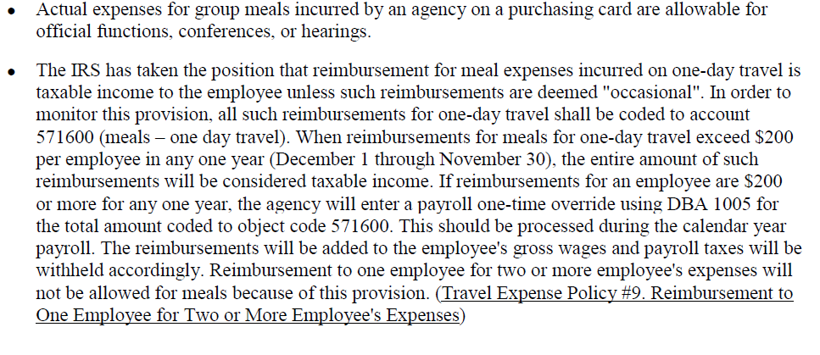

Slide 13
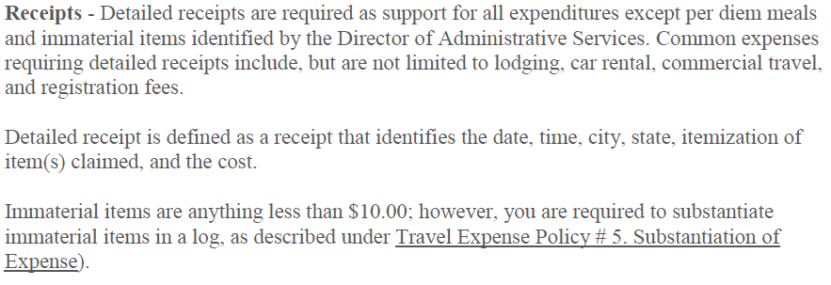
Travel Policy #8 – Receipts

Slide 14
Travel Policy #9 – Reimbursement to One Employee for Two or More Employee’s Expenses

Slide 15
Object Code Updates
Current Object Codes
Future Object Codes

Slide 16
Current
533900 | FOOD EXPENSE | Cost of food purchases for facilities. Food purchases for conferences other than State employees, Volunteers and Contractors. Use this account when making payment to a vendor. (If you are reimbursing an employee for food costs, use account 571600, 571100, and 571900.)
571100 | BOARD & LODGING | Costs of all meals and lodging accommodations incurred while in travel status for the State.
571600 | MEALS - WHILE NOT TRAVEL STATUS | Limited applicability related to meals for individuals required to attend official functions, conferences, or hearings.
571900 | MEALS – ONE DAY TRAVEL | Reimbursement for breakfast or supper when the employee is traveling on state business for one day only. No reimbursement for the noon meal. (Reference CONC-005)
Notes:
When cancelling a PO, it will ask if you are sure…choose Yes. Then it will bring up a screen for you to leave a comment on why PO is being cancelled. You will still need to save after this.

Slide 17
Future
533900 | FOOD EXPENSE – INSTITUTIONS | Bulk food purchased for group homes, institutions, prisons, educational, or other facility
571100 | LODGING | Costs of lodging accommodations incurred while in travel status for the State.
571600 | MEALS – TAXABLE | Expenses related to meals for individuals when not in travel status to attend official functions, conferences, hearings, and/or same day travel meal reimbursements. All are subject to being considered a taxable benefit when the value of meals received exceed $200 for a twelve-month period.
571800 | MEALS – TRAVEL STATUS | Meals reimbursed on a Per Diem basis while in travel status
Notes:
When cancelling a PO, it will ask if you are sure…choose Yes. Then it will bring up a screen for you to leave a comment on why PO is being cancelled. You will still need to save after this.

Slide 18
Updated ERD Form
Additional Tab in Excel Document
GSA Rates and Locations
Check Boxes to Select Meals Purchased
Check Boxes to Designate First / Last Day of Travel
One Row Per Day to Record Meals
Incidentals Included in Total per Day
Definition of Terms Included

Slide 19
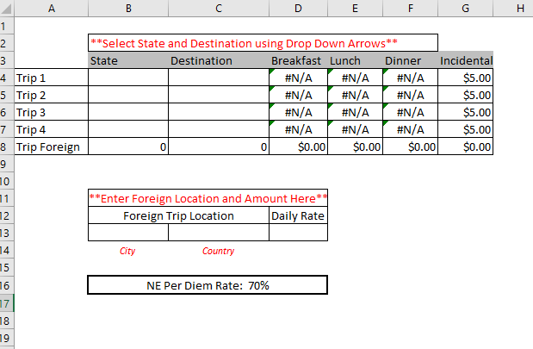
Notes:
When cancelling a PO, it will ask if you are sure…choose Yes. Then it will bring up a screen for you to leave a comment on why PO is being cancelled. You will still need to save after this.

Slide 20
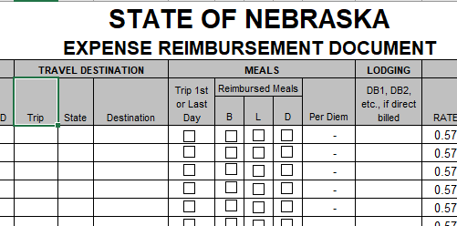

Slide 21
Definition of Terms
Per Diem: The allowance for meals (including tips) and incidental expenses. The State per diem base rate is calculated from the General Services Administration (GSA) rate.
Incidental Expenses: Federal Travel Regulation describes these only as: fees and tips given to porters, baggage carriers, hotel staff, and staff on ships.
Group Meal: Official functions, conferences, or hearing only. Attendees could include state employees who are in travel status, state employees who are not in travel status, and/or non-state employees. The actual expense for the meal would be paid and must be charged on a state purchasing card.

Slide 22
Destination City: The main location of your travel. This city will be used for the calculation of per diem meals for the entire trip.
International Travel: Use the specific ERD form for Foreign Travel. Meal per diem rates can be checked by using this link - https://aoprals.state.gov/web920/per_diem.asp
GSA Per Diem Rates: Link to view the rates for travel within the contiguous United States - https://www.gsa.gov/travel/plan-book/per-diem-rates
Link to view rates for travel within Alaska, Hawaii, or a US territory - https://www.defensetravel.dod.mil/site/perdiemCalc.cfm
Headquarter City: The location of your office
Immaterial Items: Expenses incurred for less than $10.00.

Slide 23
ERD Training Video
Travel Examples covered in training:
Out of State Conference
Out of State Training
Multiple Day Travel in Nebraska
One Day Travel
International Travel

Slide 24
https://das.nebraska.gov/accounting/fin-report.html
Administrator’s Correspondence
Contact Info
Philip.Olsen@Nebraska.gov, 402-471-0600
Chad.Pinger@Nebraska.gov, 402-416-1535

